Slide 1
Simulation and Game Theory

Slide 2
Agenda
Simulation
Game Theory
With some simulation

Slide 3
Revisiting Portfolio Optimization

Slide 4
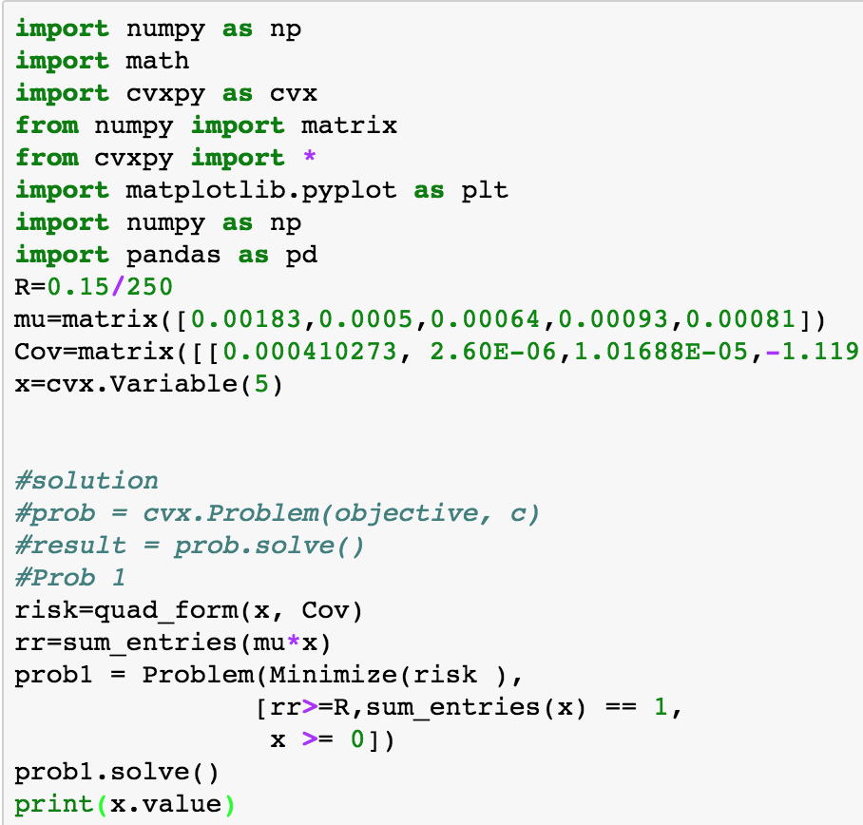
Simulation

Slide 5
Value of the Portfolio

Slide 6
Value of the Portfolio after T days?

Slide 7
Simulating

Slide 8
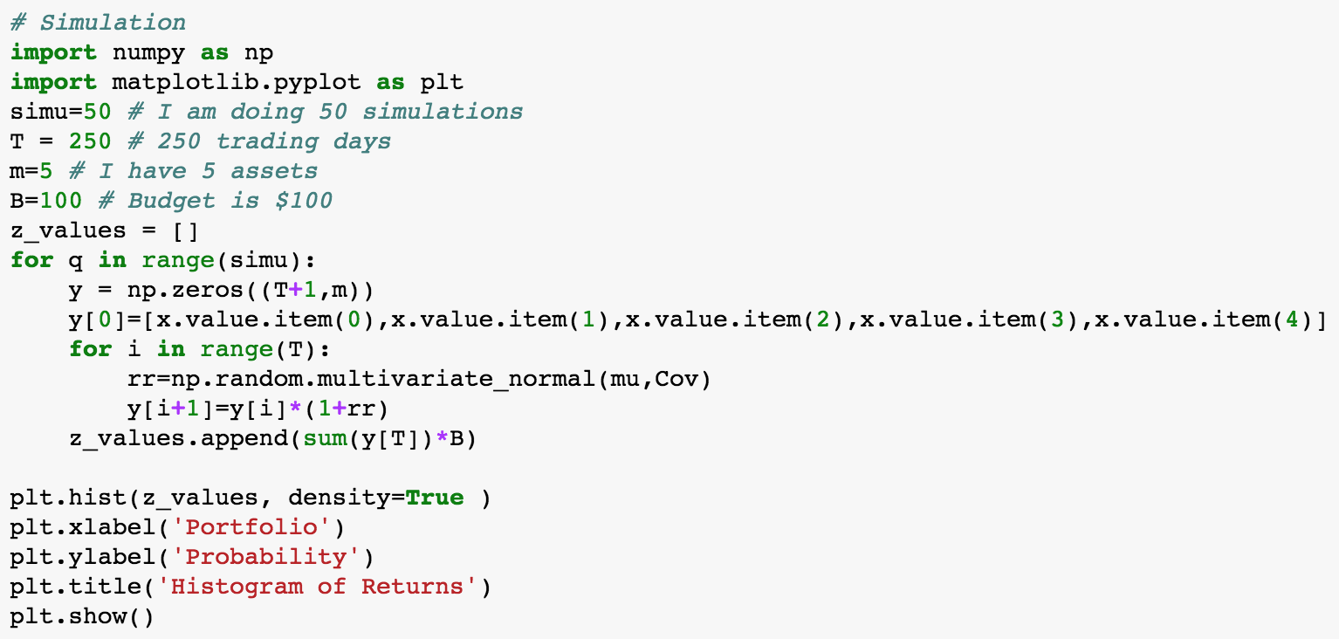
Simulation

Slide 9
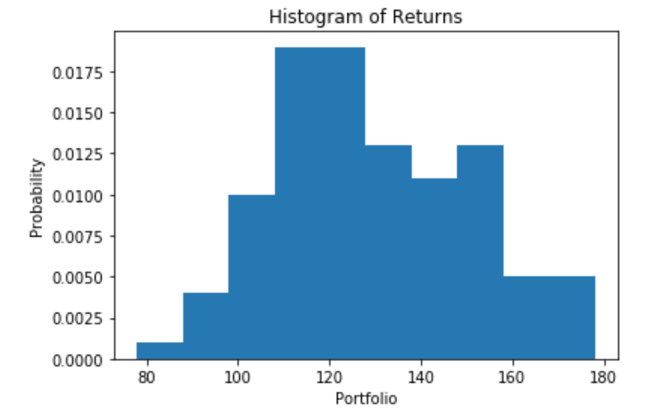
Histogram

Slide 10
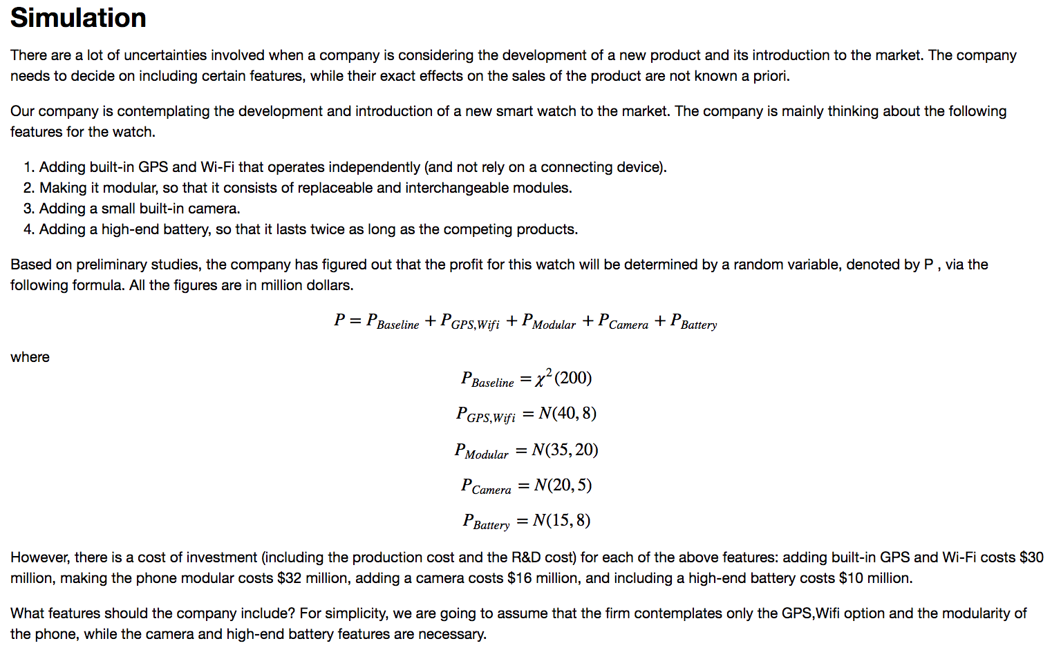
NPD Simulation

Slide 11
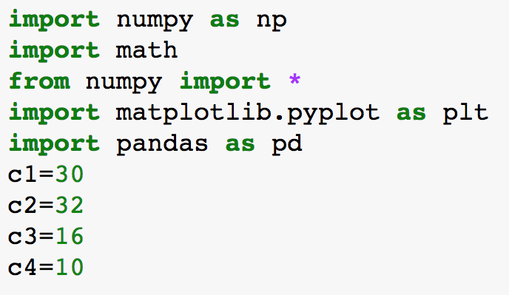
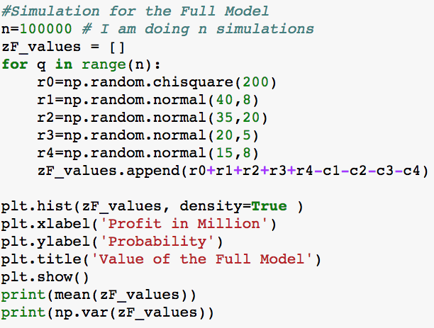
Simulating the Value of the Full Model

Slide 12
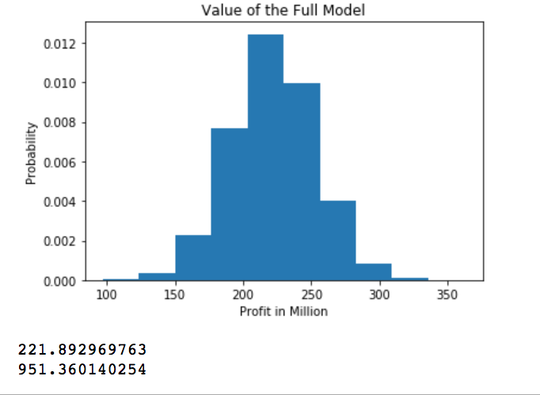
Solution

Slide 13
Now you do it
Simulate the following models
With everything, except the battery
With everything, except the modularity
With everything except modularity and the battery

Slide 14
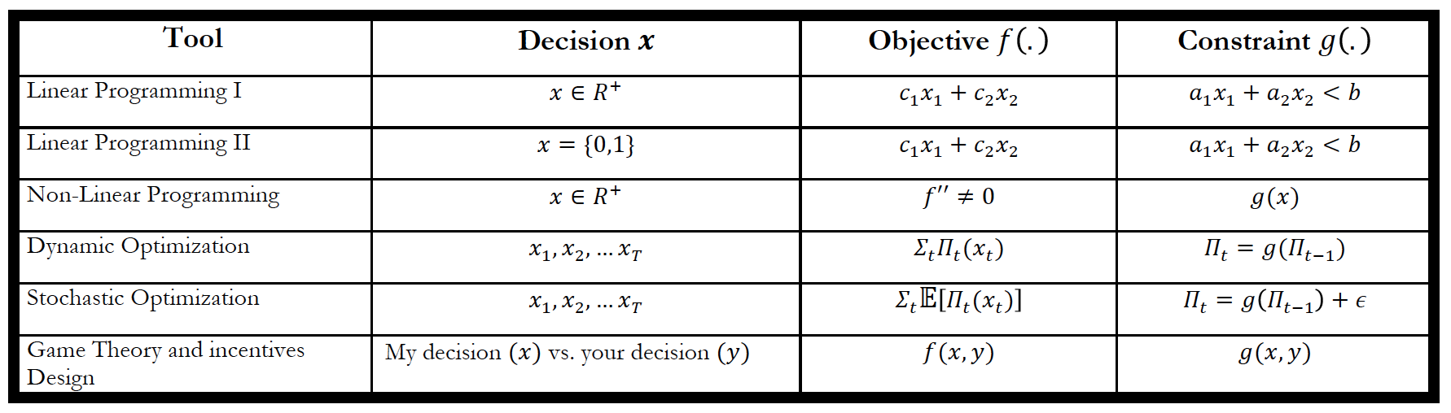
Game Theory
Game theory (hereafter GT) is a powerful tool for analyzing situations in which the decisions of multiple agents affect each agent’s payoff.
GT deals with interactive optimization problems.

Slide 15
Important Concepts
Nash equilibrium vs. Stackelberg equilibrium
Best response function (or reaction function)
Dominant Strategy
Incentive compatible

Slide 16
Game Theory Frameworks
Non-Cooperative Game Theory
Each player seeks to maximize his own payoff
Cooperative Game Theory
All players seeks to maximize a common objective

Slide 17
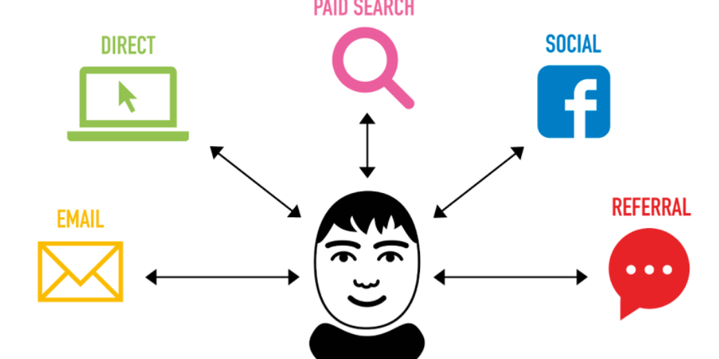
Cooperative GT
Main concept is the Shapley Value
Used in Digital Attribution Models

Slide 18
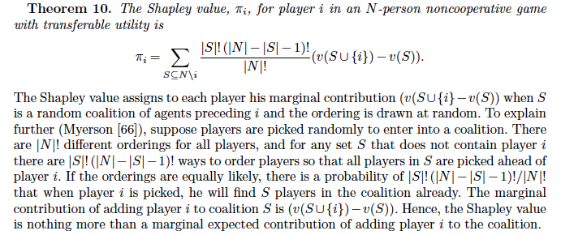
Shapley Value see Reading on Canvas

Slide 19
Applications of Non-Cooperative GT
Standards adoption
Price wars
Advertising Game
Standards war
Patent races
Capacity Expansion
Sales Force compensation
Paid Search Advertising
Coordination
Prisoner’s dilemma
Prisoner’s dilemma
War of attrition
War of attrition
Commitment
Principal-Agent Framework
Auctions

Slide 20
Small Game

Slide 21
Non-Cooperative Game Theory (see Reading on Game Theory Models of Pricing)
Definition of a game:
Players, strategies, payoffs
Equilibrium concept:
Nash or Stackelberg

Slide 22
Pricing Game
Our Price Change
Competitor
Reaction
Elasticity
Own Elasticity
Competitor Price Change
Our Volume Change
Cross Elasticity

Slide 23
Cross Price Elasticity
Effect of Tide on Era

Slide 24
Nash Equilibrium

Slide 25
Pricing Example 1

Slide 26
Reaction Functions

Slide 27
Prisoners’ Dilemma

Slide 28

Ads on YouTube

Slide 29
Definition of the Game
What is the market?
Who are the players?
What are their strategies?

Slide 30
Nash Equilibrium
The market maker (or platform) decides the pricing scheme
Second Price Auction
Bidders’ optimal strategies is to bid their true values
Bidding truthfully is the Nash equilibrium
It is “Incentive Compatible”

Slide 31
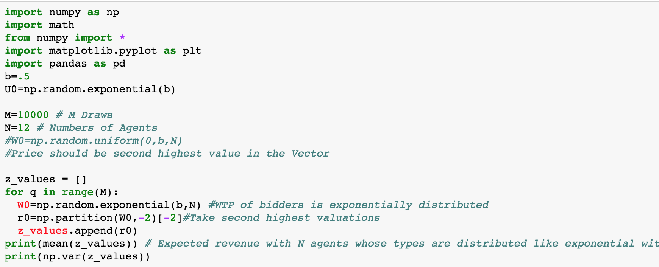
Profit under Second Price Auction

Slide 32
Important Concepts
Next week: Auction
Nash equilibrium vs. Stackelberg equilibrium
Best response function (or reaction function)
Dominant Strategy
Incentive compatible

